Slide 1


Upstate Federal Credit Union
New Branch – Pendleton, SC
Weekly Photo Update
Week Ending 03/15/24

Slide 2

This Week’s Activities:
Mobilized the site
Installed silt fence
Removed trees
Cut construction entrance
Removed top-soil
Removed fence
Received storm drain piping on site

Slide 3

Next Week’s Activities:
Begin construction on retention pond
Cut and fill with BLE
CEPSCI inspections start
Meet with Duke Energy for placement of temporary power and trailer

Slide 4
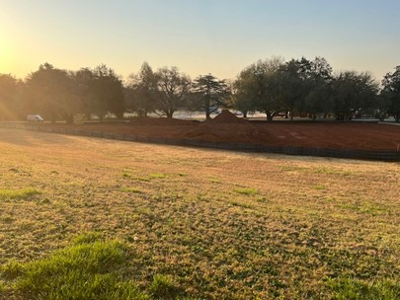

Slide 5
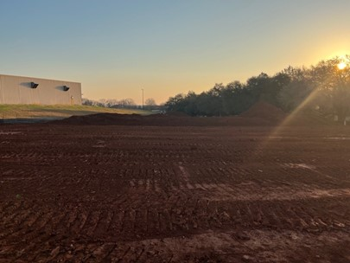

Slide 6
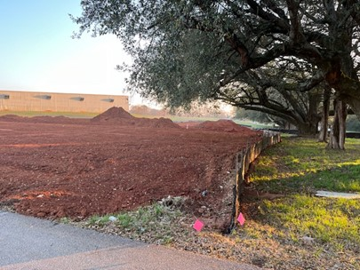

Slide 7
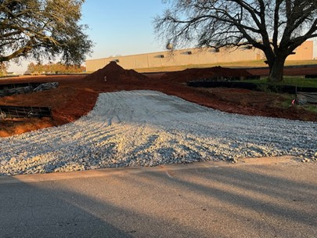

Slide 8
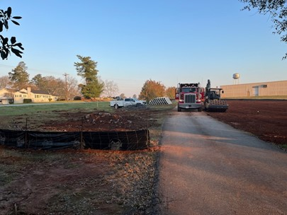

Slide 9
